Slide 1
National Wetlands Delineation
A geospatial based approach in Zimbabwe
Webster Gumindoga
University of Zimbabwe

Slide 2
Outline
Introduction/Background
Statement of the problem
Objectives
Methodology & Activities
Final Results/Outputs
Conclusions
Expected/Proposed Application Areas
Stakeholders and Users

Slide 3
Introduction/Background
Wetlands are one of the country’s vital ecosystems
They provide ecological goods and services
Loss & degradation of Zimbabwe wetlands due to:
Anthropogenic activities - mining and brick moulding and groundwater exploration
Rapid expansion of illegal settlements both urban and peri urban areas
Climate change induced droughts
Weak institutional arrangements for managing natural resources
Lack of knowledge of spatial extent of wetlands so as to prohibit developments

Slide 4
Objectives/Statement of the Problem
To provide current geospatially referenced information on the status, extent, characteristics and functions of wetlands, and related aquatic habitats in priority areas which is key in developing strategies for their protection and sustainable utilisation.
Delineate wetlands across all geographic landscapes in Zimbabwe
Characterize all Zimbabwe wetlands based on the delineation outcome
Develop a geospatial database of all wetlands which will aid in the development of decision making, sustainable strategy for their conversation

Slide 5
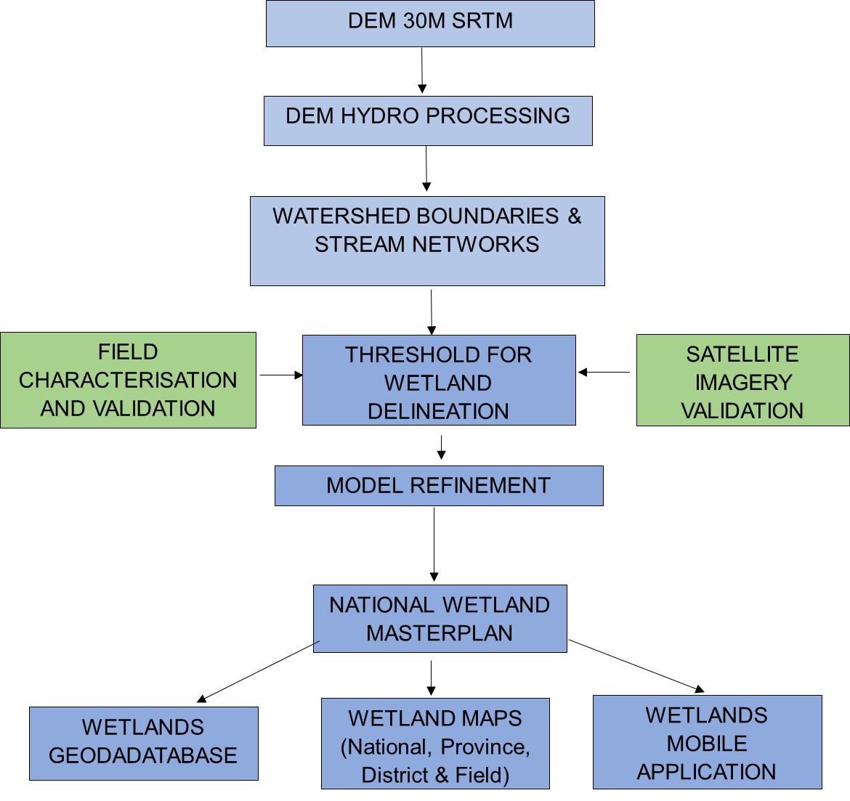
Methodology –Approach to wetland delineation
Hydrological analysis of the DEM covering Zimbabwe, was done at the Zimbabwe Centre for High Performance Computing (ZCHPC).
Flow accumulation information determines watershed boundaries and stream networks.
DEM Hydro-Processing

Slide 6
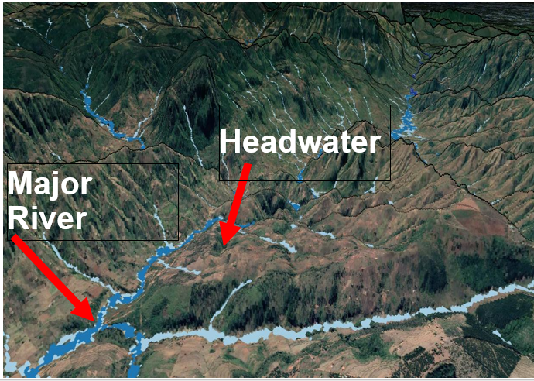
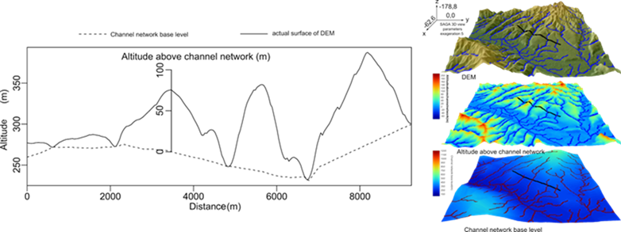
Methodology –Approach to wetland delineation
Height above Channel
Vertical height above the nearest channel (H) determined by subtracting channel base height interpolation (r) from original DEM (v).
H = v − r

Slide 7
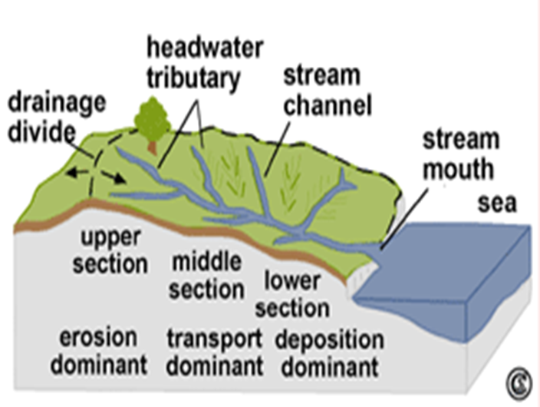
Methodology –Approach to wetland delineation
Catchment cross section defining a wetland
The landscape of the wetlands catchment can be divided into the following wetland areas:
headwater (upper section)- high sensitivity
middle reach (middle section) –medium sensitivity
major river (lower section)-low sensitivity

Slide 8
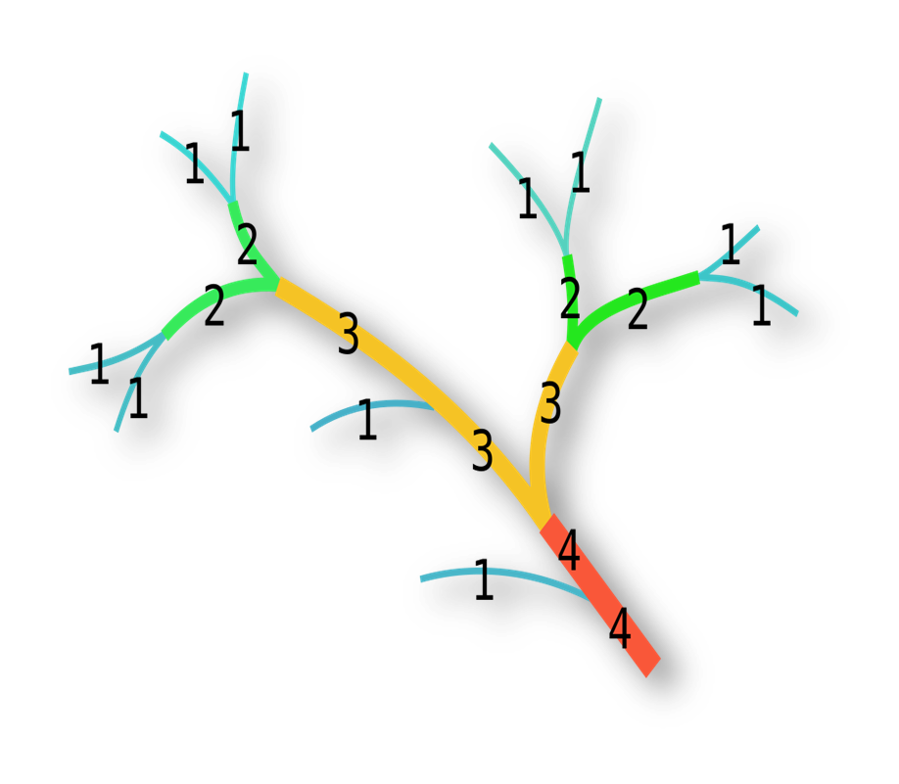
Methodology –Approach to wetland delineation
Threshold for Wetland Delineation
The height above channel was derived for all channels down to Strahler order 4.

Slide 9
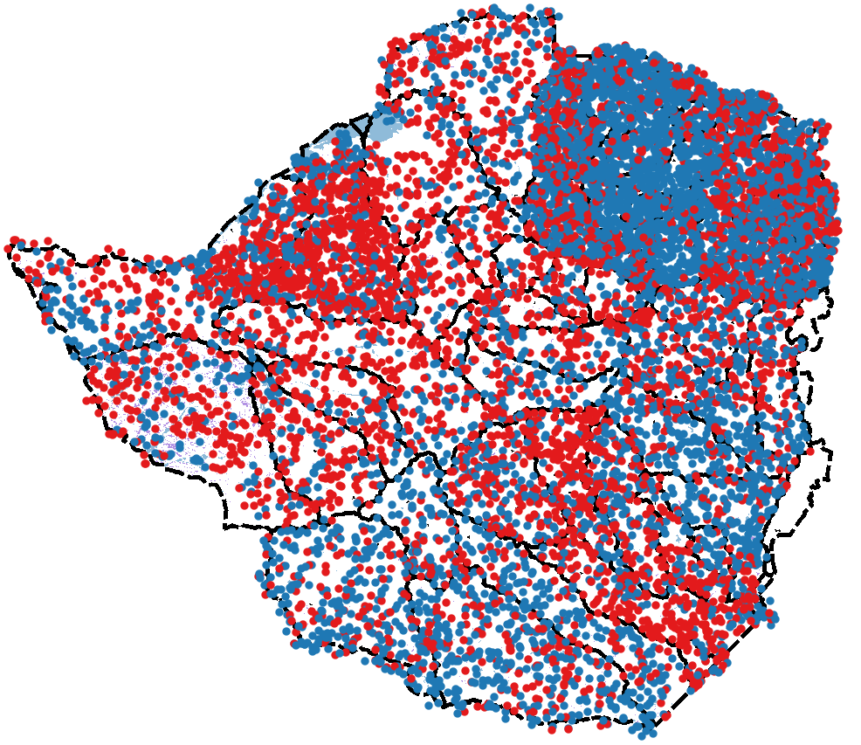
Methodology –Approach to wetland delineation
Thresholding for wetland delineation
Satellite image interpretation used for deriving the best threshold based on 10 000 randomly placed sample points

Slide 10
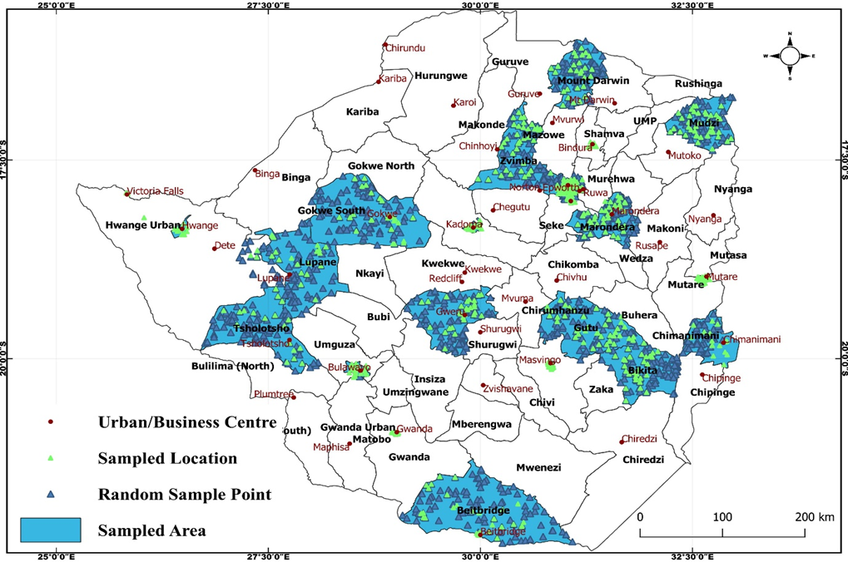
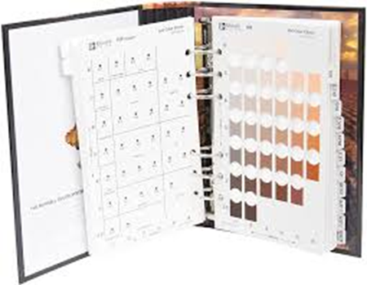
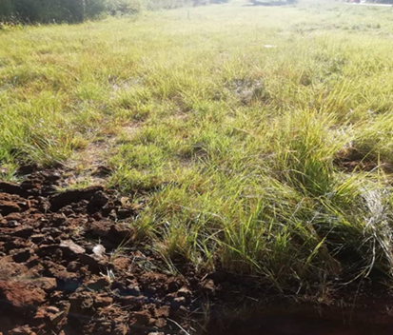
Methodology –Approach to wetland delineation
Fieldwork Validation
Fieldwork was toured to observe:
Wetland features
Soil characteristics
Flora and Fauna
Wetland condition

Slide 11
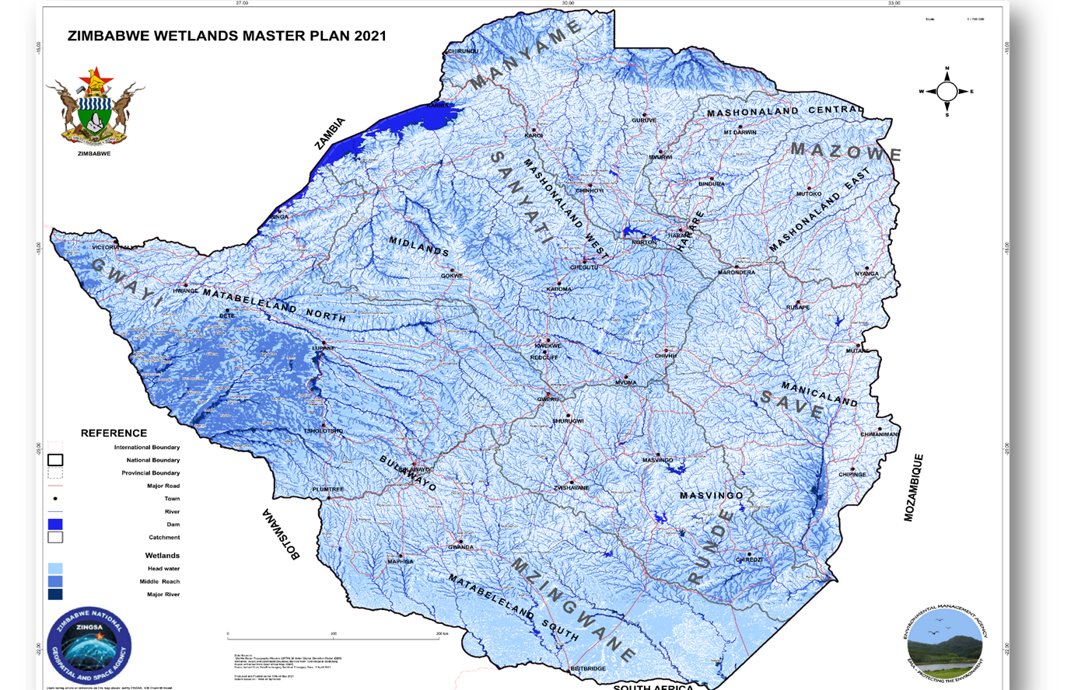
Final Results/Outputs
National Wetlands Map of Zimbabwe

Slide 12
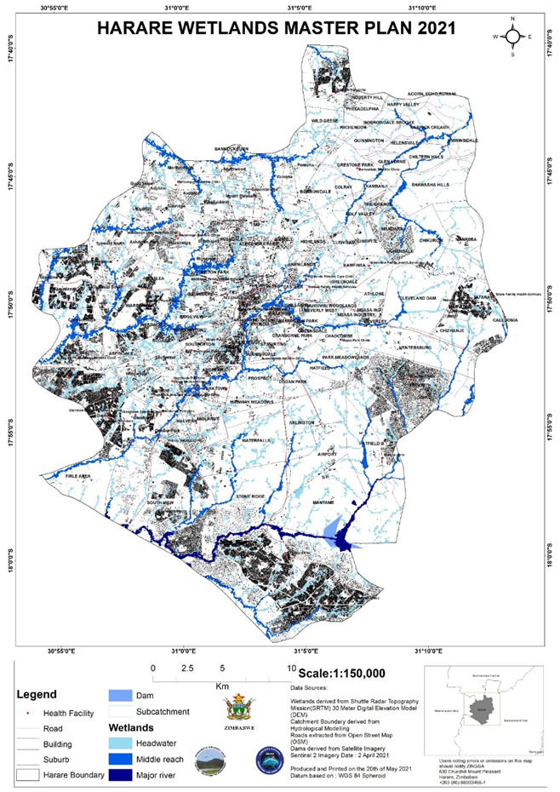
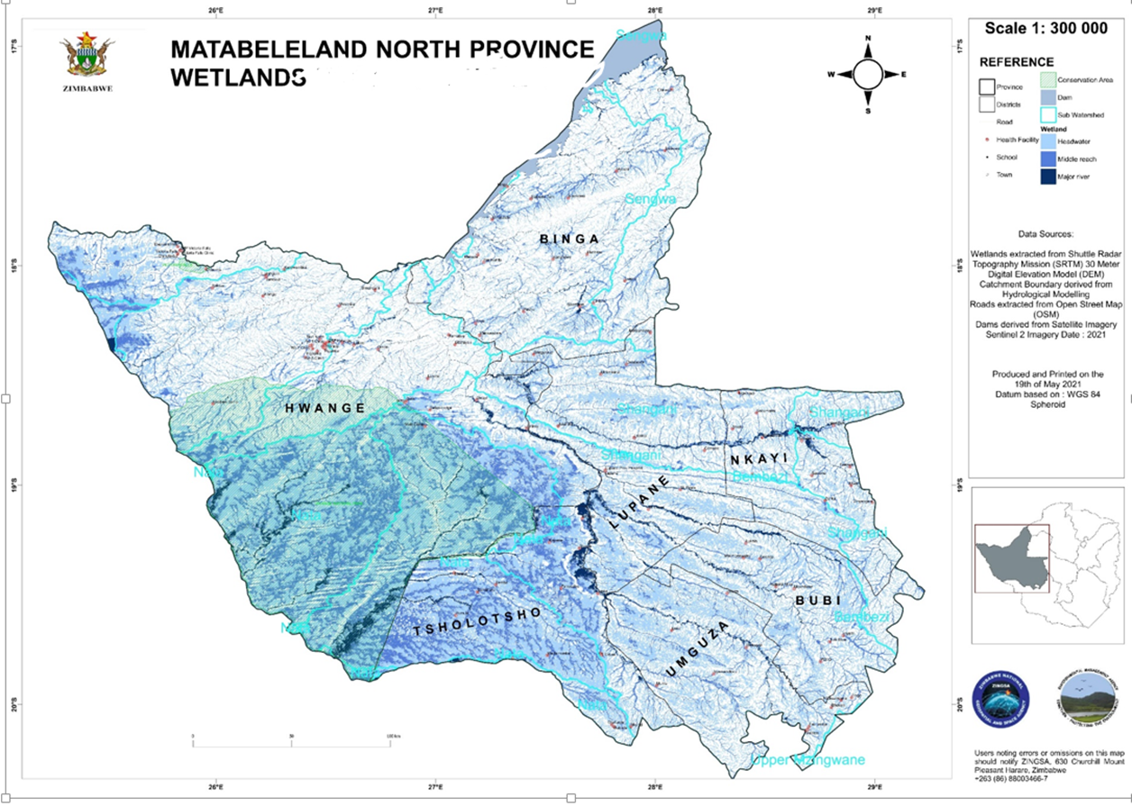
Final Results/Outputs
Provincial & District Outputs

Slide 13
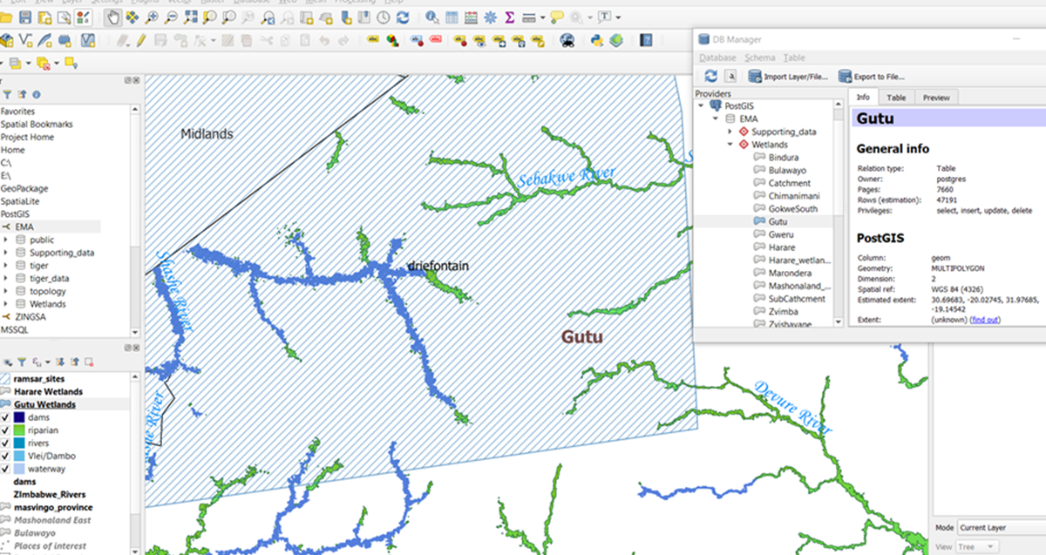
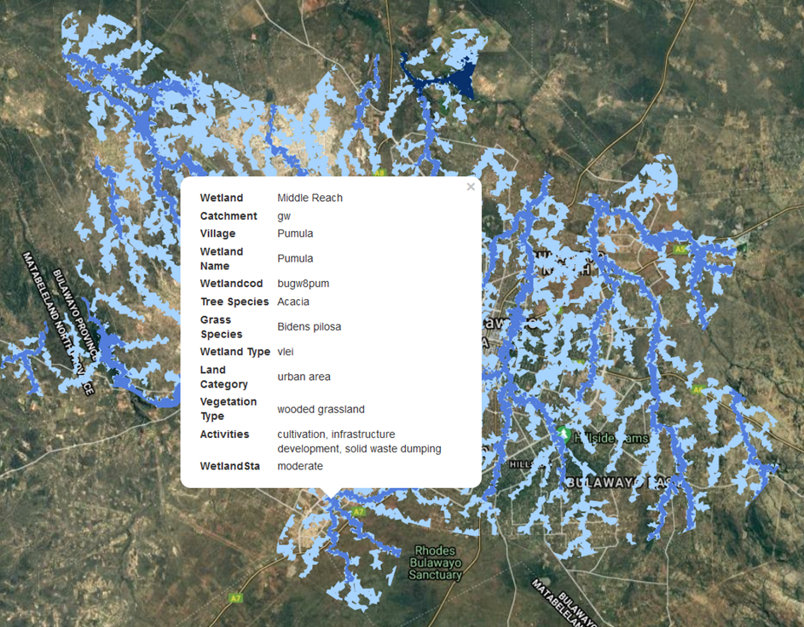
Final Results/Outputs
Wetland Geodatabase

Slide 14
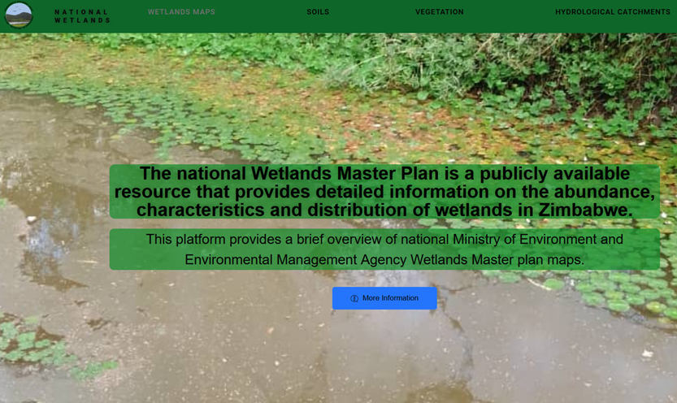
Final Results/Outputs
Wetland Interactive Map

Slide 15
Conclusions
For the first time we have a Zimbabwe Wetlands Map
With provincial/district/local authorities submaps
Database of all wetlands in the above jurisdiction exists
Masterplan can be used for integrated wetland management
Study demonstrates the application of GIS and Earth Observation techniques to support national projects

Slide 16
Expected application areas of the research/product/tool/service
A geo-database and interactive web tool containing wetland details and geometric attributes such as:
Name
wetland boundary location;
surface area, and centre-point coordinates;
Biotic and abiotic details
The database is continuously updated and users have access rights according to their roles/duties
Master plan seeks to :
Strengthen institutional and operational capacity for effective integrated wetland management at national, provincial level at selected sites,
strengthen national and provincial capacities for planning, administering and managing wetland areas

Slide 17
Collaborators, Stakeholders and Users
Collaborators
University of Zimbabwe Researchers
Zimbabwe Geospatial and Space Agency (ZINGSA) scientists
Environmental Management Agency (EMA)- custodian of the output
Scientific and Industrial Research and Development Council (SIRDC)
Users
Local Authorities and District Councils
Water Management Board
Academic Institutions
Users of spatial data

Slide 18
Acknowledgement
^{ZINGSA}
^{EMA}
^{SIRDC}

Slide 19
Thank you
Questions?

